Slide 1
Bom Futuro Komatsu Fleet Support Program
MMK+ Komatsu Mais + Komtrax 10 anos +
– Projeto Bom Futuro
Fernando Coradi
Dez/2025

Slide 2
Status Komatsu Overview
Summary of the current fleet condition, performance trends, and service alignment between Komatsu and Bom Futuro.
Identification of gaps (“Delta”) and strategic actions required to achieve long‑term reliability and cost targets.
1. Context and Goals
2. Definition of the Delta
Scope: Bom Futuro fleet (models, volumes, production mission).
Performance Goals:
Delta 5 years / 10,000 h
Delta 10 years / 10,000 h
KPIs: Availability, MTBF, MTTR, Cost/hour, Fuel consumption, Unscheduled events.
Adjusted Topic + Calculation Methodology:
Below is the methodology used to calculate the DELTA between 0–5,000 hours (actual cost) and 5,000–10,000 hours (projected cost), based on three failure‑rate scenarios:
Conservative: projection based on historical trend with a 10% increase in failure rate after 5,000 h.
Realistic: projection assuming a 50% increase in failure rate after 5,000 h.
Aggressive: projection assuming a 100% increase (2×) in failure rate after 5,000 h, aligned with the stress‑scenario modeling.
Important: Machines with SMR equal to or below 250 hours are not included in this proposal.
3. 📌 Proposals” (options A/B/C)
1# Full dealer‑supported maintenance ensures maximum reliability through certified processes, Komatsu Genuine Parts, structured inspections, and continuous monitoring => resulting in the lowest probability of unplanned failures and cost deviation
2# Customer-led maintenance without a dealer contract maintains autonomy but increases responsibility for process execution and documentation. Risk is mitigated through mandatory use of Komatsu Genuine Parts.
3# Remote technical supervision combines customer‑executed maintenance with structured oversight from Komatsu specialists. Risk reduction is achieved through disciplined task registration. This approach preserves technical governance while enabling cost savings and expanding coverage to remote operations.
Plan A – with Dealer support
Plan B – Without a maintenance contract with the Dealer
“Delta”
Plan C – In‑house Operation with Remote Technical Support

Slide 3
Comparison A / B / C
Overview of the fleet, operational targets, and the status of Komatsu services for the Bom Futuro customer;
Risks and Benefits: greater in‑person support versus reduced support with potential expansion of remote coverage.
✔ Prerequisites (Plan A – with Dealer support)
✔ Plan B – Without a maintenance contract with the Dealer
✔ Plan C – In‑house Operation with Remote Technical Support
MMK+Komatsu Mais
Technical Delivery and Initial Checklist
Activation and validation of KOMTRAX (telemetry)
Mandatory Service
  3 months (PMP + KOWA + GET/UMS Inspection)
  6 months (PMP + KOWA + GET/UMS)
  1 months (PMP + KOWA + GET/UMS)
Execution of Systematic Preventive Maintenance under Dealer/Komatsu responsibility
Having the Regional Dealer available to perform PMP activitiesi) Komatsu Genuine Parts (performance assurance and traceability)
Registration in EqpCare and monitoring of critical events, campaigns, and improvements
Concept of Plan B:The customer chooses not to have a maintenance contract with the Dealer and begins performing 100% of the maintenance on their own (PMs, corrective repairs, inspections, and adjustments). Komatsu acts through technical supervision, ensuring methodology, standards, and mandatory recommendations from the Field Engineer, while all operational work remains under the customer’s responsibility.
Conceito do Plano C, o cliente executa 100% da manutenção, incluindo PMs, corretivas e inspeções, porém, com a Supervisão técnica remota de um Engenheiro de Campo (BackOffice), requer Registro disciplinado das operações e inspeções em MTA + SSA + ASSA,:KOWA (análise de óleo preditiva) + Alarmes Komtrax,
📌 Highlight
📌 Highlight
The customer performs 100% of the maintenance (PMs, corrective repairs, and inspections), while Komatsu provides remote technical supervision and data‑based governance.
Remote Technical Supervision – Field Engineer (BackOffice)
Mandatory Activity Records (Customer):
MTA – task registration
SSA – daily inspections
ASSA – assessments (structural / systemic)
Predictive and Continuous Monitoring: KOWA / KomtraxPerformance Metrics presented monthly, with action plans for KPI improvement
Prerequisites + (HC‑KBI reinforcement): Attention – Direct KBI ↔ Customer interface
Direct technical relationship between KBI and the customer, without Dealer mediation
I do not want a maintenance contract with the Dealer
In‑house operation without Komatsu supervision.
Genuine Parts – Mandatory Use of Komatsu Genuine Parts as a technical requirement of the plan, and the customer must maintain a minimum stock level as recommended by the Engineer + MPPS.
Prerequisites + (HC‑KBI reinforcement):
Attention – Direct KBI ↔ Customer interface
Direct technical relationship between KBI and the customer, without Dealer mediation.
High probability of loss of traceability due to the lack of structured records (PMs, inspections, events).
Warranty provision and technical liability risk arising from customer decisions that do not follow Komatsu methodology.
📌 Highlight
Komatsu Genuine Parts (performance assurance and traceability).Registration in EqpCare (all critical events, campaigns, and improvements).Dealer responsibilities: process audits, advanced technical support, training..

Slide 4
Amount warranty claim by SMR (CPU-Custo Unitário Produto)
Comparison of projected warranty costs per machine across conservative, realistic, and aggressive scenarios.
Highlights cost variation among models based on different operational and failure‑rate assumptions.

Slide 5
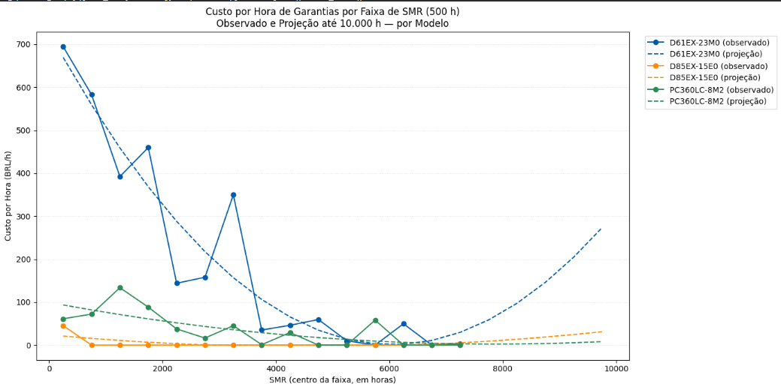
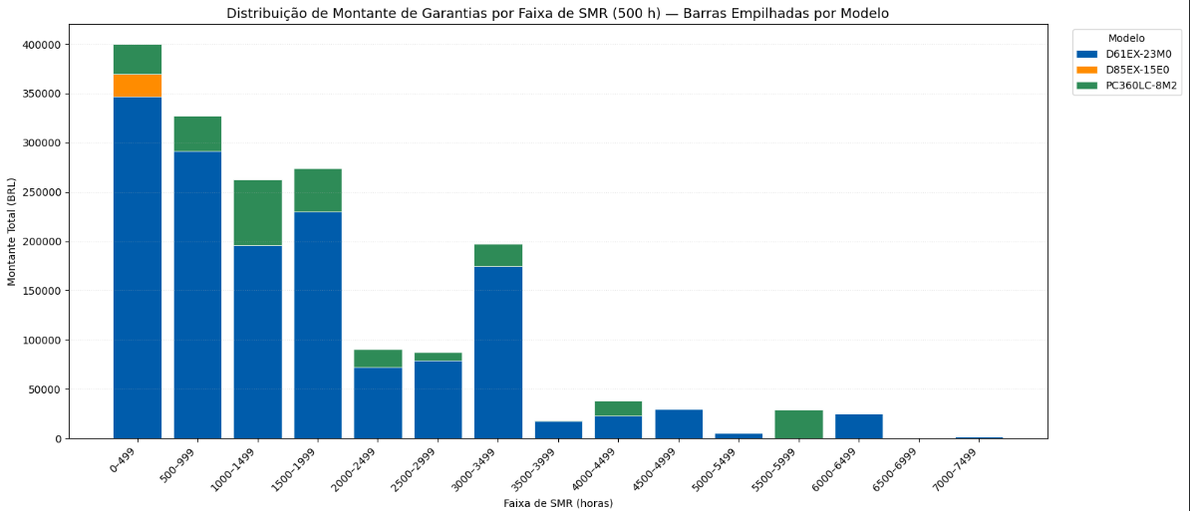
Amount warranty claim by SMR
Shows the observed and projected warranty cost per operating‑hour band, enabling trend analysis up to 10,000 hours for each model.
Illustrates cost‑per‑hour behavior by SMR range, comparing real historical data with forward‑looking projections.

Slide 6
